Slide 1
Data Preparation
CSE5072 – Data Mining and Knowledge Discovery

Slide 2



Outline
Data Integration
Data Selection and Reduction
Data Preprocessing and Data Cleaning
  Filling in Missing Values
  Removing Noisy Data
  Identification of Outliers
  Correcting Inconsistent Data
Data Transformation Techniques
  Normalization
  Discretization

Slide 3

Data Preparation

Slide 4
Data Preparation
Data
Selection &
Reduction
Data
Data Integration
Data
Preprocessing
Data
Transformation

Slide 5
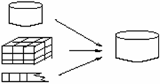
Data Integration
Data integration
  Integration of multiple databases, data cubes, or files
  Obtain data from various sources
Database
Data Integration
Data Cube
File

Slide 6
Data Preparation
Data
Selection &
Reduction
Data Integration
Data
Preprocessing
Data
Transformation

Slide 7
Data Selection & Reduction
Data Reduction
  Selecting a target data set
  Removing duplicates
Data Reduction
  Obtains reduced representation of the data set
  (smaller in volume but yet produces the same (or almost the same) results
Why data reduction?
  A database/data warehouse may store terabytes of data
  Complex data analysis/mining may take a very long time to run

Slide 8
Data Reduction Strategies
1- Data Aggregation — e.g., sum, average
2- Dimensionality Reduction — e.g., remove unimportant attributes
3- Data Compression — e.g., encoding mechanisms
4- Sampling — e.g., fit data into models
5- Clustering — e.g., cluster data
6- Concept hierarchy generation — e.g., street < city < state < country

Slide 9
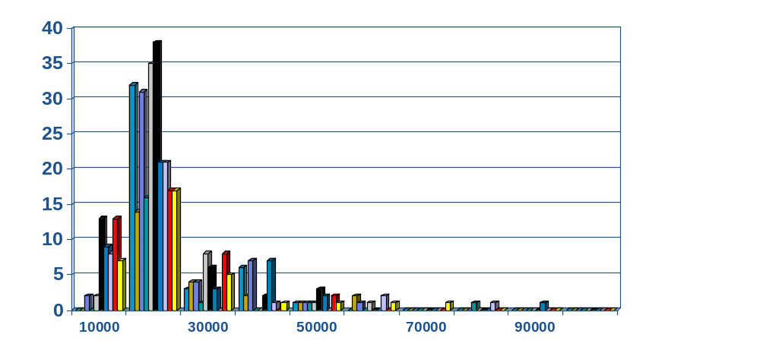
1- Data Aggregation
Data aggregation is any process in which information is gathered and expressed in a summary form.
Summarization
Example (Histograms):
  A popular data reduction technique
  Divide data into buckets and store average (or sum) for each bucket

Slide 10
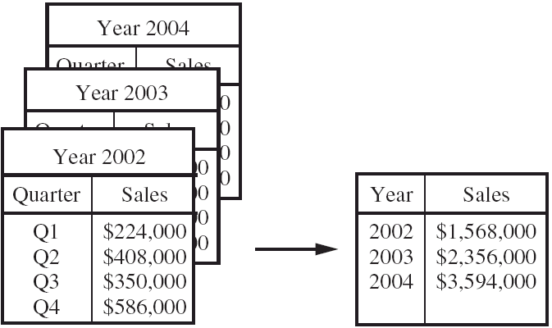
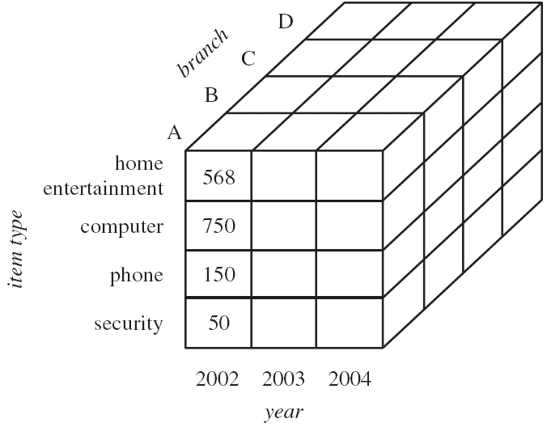
Data Aggregation Example

Slide 11


2- Dimensionality Reduction
Attribute subset selection
Remove unimportant attributes
Remove redundant and/or correlating attributes
Combine attributes (sum, multiply, difference)
Example (Decision Tree Induction) :
Initial attribute set: {A1, A2, A3, A4, A5, A6}
Reduced attribute set: {A1, A4, A6}
A4 ?
A1?
A6?
Class 1
Class 2
Class 1
Class 2

Slide 12
3- Data Compression
Data compression is the process of reproducing information in a more compact form.
  Number comsression
  String compression
  Image/Audio/Video compression
Lossless vs. Lossy Compression
  Original Data
  25.888888888
  Lossless system
  25.[9]8
  Lossy system
  26
Original Data
Compressed
Data
lossless
Original Data
Approximated
lossy

Slide 13
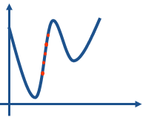
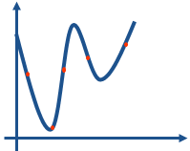
4- Sampling
Sampling: obtaining a small sample s to represent the whole data set N.
  Representative Sampling
    Simple random sampling may have very poor performance
  Stratified Sampling
    Develop adaptive sampling methods
    Approximate the percentage of each class in the overall database
Raw Data
Cluster/Stratified Sample

Slide 14
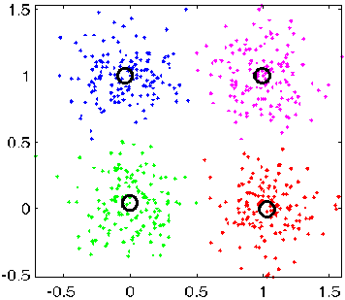
5- Clustering
Partition data set into clusters based on similarity, and store cluster representation (e.g., centroid and diameter only)
There are many choices of clustering definitions and clustering algorithms.
C1
C2
ID | Gender | Age | Marital Satatus | Score | Cluster
1021 | F | 41 | NeverM | 55 | C1
1022 | M | 27 | Married | 35 | C1
1023 | M | 20 | NeverM | 480 | C2
1024 | F | 34 | Married | 950 | C3
1025 | M | 74 | Married | 500 | C2
1026 | M | 32 | Married | 500 | C2
1027 | M | 18 | NeverM | 890 | C3
1028 | M | 54 | Married | 68 | C1
… | … | … | … | … | …
C3
C4

Slide 15
6- Concept Hierarchy Generation
Replace low level concepts (such as numeric values for age) by
higher level concepts (such as young, middle-aged, or senior)
Specification of a hierarchy for a set of values by explicit data grouping
  {Urbana, Champaign, Chicago} < Illinois
The attribute with the most distinct values is placed at the lowest level of the hierarchy
  street < city < state < country
country
15 distinct values
state
365 distinct values
city
3567 distinct values
street
674,339 distinct values

Slide 16
Data Reduction Examples
Tutar <= 5 TL
SatışID | Ürün | Tarih | ToplamTutar | SatıldığıYer
1 | Domates, Peynir, Kola | 1.1.2008 | 45 | İzmir
2 | Makarna, Çay | 3.1.2008 | 55 | İstanbul
3 | Saç Bakımı | 5.1.2008 | 5 | İstanbul
4 | Sigara, Bira | 8.1.2008 | 25 | İzmir
Horizontal
Data
Reduction
Concept Hierarchy
Generation
Vertical Data Reduction
SatışID | Ürün | Tarih | Tutar | SatıldığıYer | Açıklama
1 | Domates | 1.1.2008 | 20 | Buca | .....
1 | Peynir | 1.1.2008 | 10 | Buca | .....
1 | Kola | 1.1.2008 | 15 | Buca | .....
2 | Makarna | 3.1.2008 | 25 | Mecidiyeköy | .....
2 | Çay | 3.1.2008 | 30 | Mecidiyeköy | .....
3 | Saç Bakımı | 5.1.2008 | 5 | Kadıköy | .....
4 | Sigara | 8.1.2008 | 15 | Bornova | .....
4 | Bira | 8.1.2008 | 10 | Bornova | .....
İzmir
İstanbul
İstanbul
İzmir

Slide 17
Data Preparation
Data
Selection &
Reduction
Data Integration
Data
Preprocessing
Data
Transformation

Slide 18
Why Is Data Preprocessing Important?
No quality data → No quality mining results
Quality decisions must be based on quality data
  e.g., duplicate or missing data may cause incorrect or even misleading statistics.
Data warehouse needs consistent integration of quality data

Slide 19

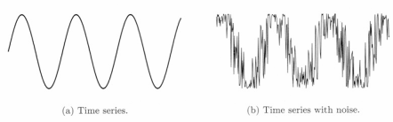
Why Data Preprocessing?
Data in the real world is dirty.
Incomplete: lacking or missing attribute values
  e.g., occupation=“”
Noisy: containing errors or outliers
  e.g., Salary=“-10”
Inconsistent: containing discrepancies in codes or names
  e.g., Age=“42” Birthday=“03/07/1976”
  e.g., Was rating “1,2,3”, now rating “A, B, C”
  e.g., discrepancy between duplicate records
  e.g., different meanings (annual, yearly)
Outliers

Slide 20
Example Errors
NAME
M.Ulku
Metin Ü.
SURNAME
SANER
SANRE
BIRTH DATE
10/04/1965
04.10.1965
CITY
G.ANTEB
GAZİANTEP
ADRESS
Atatürk Cd. Kemaliye Sok. No.25
Atatrk Cad. Kemaliye Mah. 25/3
TITLE
Gen. Müdr.
Genel Müdür
WORKING PLACE
G.Antep D.S.İ.
Devlet Su İşleri A.O
.........
.........
.........

Slide 21
Major Tasks in Data Preprocessing
Fill in missing values
Remove noisy data
Identify and remove outliers
Resolve inconsistencies

Slide 22
1- Filling in Missing Values
    For Example: %10 of Salary is incomplete
Solutions:
1- Ignore the tuple
  Usually done when class label is missing (in classification)
  Not effective when the percentage of missing values per attribute varies considerably
2- Fill in the missing value manually
  Tedious and infeasible
3- Fill in it automatically with
  A global constant : e.g., “unknown”, it generates a new class?
  The attribute mean
  The conditioned mean for all samples belonging to the same class
  The most probable value (use Bayesian formula or Decision Tree)

Slide 23
Example - Filling in Missing Values
Global Constant:
Most Repeated Value:
Mean:
Conditioned mean:
Most probable value:
900 (user defined)
1000
1042
1100
1200
(most similar to the customer 1021)
ID | Gender | Age | Marital Satatus | Education | Region | Salary | Cluster
1021 | F | 41 | Married | Masters | Izmir | 1200 | C1
1022 | M | 27 | Married | Bach. | Ankara | 1000 | C1
1023 | M | 20 | NeverM | High School | Izmir | 1000 | C2
1024 | F | 34 | Married | Bach. | İstanbul | 1000 | C3
1025 | M | 74 | Married | Middle | Ankara | 500 | C2
1026 | M | 32 | Married | PhD | İstanbul | 2000 | C2
1027 | M | 18 | NeverM | High School | Ankara | 800 | C3
1028 | F | 43 | Married | Master | Izmir | ? | C1

Slide 24
2- Removing Noisy Data
Solutions:
Binning
  First sort data and partition into (width or depth) bins
  Then one can
    (a) Equal Depth and Smooting by Bin Boundaries
    (b) Equal Depth and Smooting by Bin Means
    (c) Equal Width and Smooting by Bin Boundaries
    (d) Equal Width and Smooting by Bin Means
Regression
  Smooth by fitting the data into regression functions

Slide 25
A. Binning
Equal-width partitioning
  Divides the range into N intervals of equal size
  if A and B are the lowest and highest values of the attribute, the width of intervals will be: W = (B –A)/N.
Equal-depth partitioning
  Divides the range into N intervals, each containing approximately same number of samples
  (33-4) / 3 ~ 9
  Bin1 (4-13) : 4 6 Bin1 : 4 6 14 16
  Bin2 (14-23) : 14 16 18 19 21 22 23 Bin2 : 18 19 21 22
  Bin3 (24-33) : 25 27 33 Bin3: 23 25 27 33
Equal width
B1
B1
B2
B2
B2
B2
B2
B2
B2
B3
B3
B3
Price in €
4
6
14
16
18
19
21
22
23
25
27
33
Equal depth
B1
B1
B1
B1
B2
B2
B2
B2
B3
B3
B3
B3
Equal-Width Partitioning
Equal-Depth Partitioning

Slide 26

A. Binning
Replace all values in a BIN by ONE value (smoothing values)
Price in €
4
6
14
16
18
19
21
22
23
25
27
33
Equal depth
B1
B1
B1
B1
B2
B2
B2
B2
B3
B3
B3
B3
Smoothing by bin means
10
10
10
10
20
20
20
20
27
27
27
27
Smoothing by bin boundaries
4
4
16
16
18
18
22
22
23
23
23
33
5 5 19 19 19 19 19 19 19 28 28 28
4 6 14 14 14 23 23 23 23 25 25 33

Slide 27
A. Binning
Sorted data for price (in dollars): 4, 8, 9, 15, 21, 21, 24, 25, 26, 28, 29, 34
* Partition into Equal-Depth bins:
- Bin 1:
- Bin 2:
- Bin 3:
* Smoothing by bin means:
- Bin 1:
- Bin 2:
- Bin 3:
* Smoothing by bin boundaries:
- Bin 1:
- Bin 2:
- Bin 3:
* Partition into Equal-Width bins:
- Bin 1:
- Bin 2:
- Bin 3:
* Smoothing by bin means:
- Bin 1:
- Bin 2:
- Bin 3:
* Smoothing by bin boundaries:
- Bin 1:
- Bin 2:
- Bin 3:

Slide 28
Binning Example
Sorted data for price (in dollars): 4, 8, 9, 15, 21, 21, 24, 25, 26, 28, 29, 34
* Partition into Equal-Depth bins:
- Bin 1: 4, 8, 9, 15
- Bin 2: 21, 21, 24, 25
- Bin 3: 26, 28, 29, 34
* Smoothing by bin means:
- Bin 1: 9, 9, 9, 9
- Bin 2: 23, 23, 23, 23
- Bin 3: 29, 29, 29, 29
* Smoothing by bin boundaries:
- Bin 1: 4, 4, 4, 15
- Bin 2: 21, 21, 25, 25
- Bin 3: 26, 26, 26, 34
* Partition into Equal-Width bins:
- Bin 1: 4, 8, 9
- Bin 2: 15, 21, 21, 24
- Bin 3: 25, 26, 28, 29, 34
* Smoothing by bin means:
- Bin 1: 7, 7, 7
- Bin 2: 20, 20, 20, 20
- Bin 3: 28, 28, 28, 28, 28
* Smoothing by bin boundaries:
- Bin 1: 4, 9, 9
- Bin 2: 15, 24, 24, 24
- Bin 3: 25, 25, 25, 25, 34

Slide 29
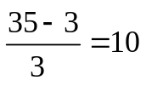
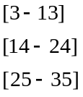
Binning Example
Örneğin: 3, 8, 10, 11, 15, 19, 23, 29, 35
Equal-Depth Equal-Width
Bin 1: Bin 1:
Bin 2: Bin 2:
Bin 3: Bin 3:
Means Means
Bin 1: Bin 1:
Bin 2: Bin 2:
Bin 3: Bin 3:
Boundaries
Bin 1: Bin 1:
Bin 2: Bin 2:
Bin 3: Bin 3:

Slide 30
Binning Example
Örneğin: 3, 8, 10, 11, 15, 19, 23, 29, 35
Equal-Depth Equal-Width
Bin 1: 3, 8, 10 Bin 1: 3, 8, 10, 11
Bin 2: 11, 15, 19 Bin 2: 15, 19, 23
Bin 3: 23, 29, 35 Bin 3: 29, 35
Means Means
Bin 1: 7, 7, 7 Bin 1: 8, 8, 8, 8
Bin 2: 15, 15, 15 Bin 2: 19, 19, 19
Bin 3: 29, 29, 29 Bin 3: 32, 32
Boundaries
Bin 1: 3, 10, 10 Bin 1: 3, 11, 11, 11
Bin 2: 11, 11, 19 Bin 2: 15, 15, 23
Bin 3: 23, 23, 35 Bin 3: 29, 35

Slide 31
B. Regression
y
Y1
Y1’
y = x + 1
X1
x

Slide 32
3- Removing Outliers
Outlier: Data points inconsistent with the majority of data
Removal methods
  Clustering
  Curve-fitting
Clustering
Outliers

Slide 33
4- Resolve inconsistencies
Data discrepancy detection
  Use metadata (e.g., domain, range, dependency, distribution)
  Check field overloading
  Check uniqueness rule, consecutive rule and null rule
Data Type Conversion may be necessary
  Different representations, different scales, e.g., metric vs. British units
For example: inconsistency in naming convention

Slide 34
Data Preparation
Data
Selection &
Reduction
Data Integration
Data
Preprocessing
Data
Transformation

Slide 35
Data Transformation
It is the process of changing the form or structure of existing attributes.
  Convert data into common format
  Transform data into new format
It involves converting data into a single common format acceptable to the data mining methodology.

Slide 36
Data Transformation Example
Data Warehouse
appl A - m,f
appl B - 1,0
appl C - x,y
appl D - male, female
encoding
appl A - pipeline - cm
appl B - pipeline - in
appl C - pipeline - feet
appl D - pipeline - yds
unit
appl A - balance
appl B - bal
appl C - currbal
appl D - balcurr
field

Slide 37
Encoding Errors
Education Field
  C: college
  U: university
  H: high school
  D: doctorate
  M: master
  S : secondary school
  P: primary school
  I : illegitimate
but X,Q,Y,T values may seen in the data

Slide 38
Data Transformation
Normalization: scaled to fall within a small, specified range
  Min-max normalization
  Z-score normalization
  Normalization by decimal scaling
Discretization
  Fixed k-Interval Discretization
  Cluster-Based Discretization
  Entropy-Based Discretization

Slide 39


Normalization
Min-max normalization: to [new_min_{A}, new_max_{A}]
Z-score normalization (μ: mean, σ: standard deviation):

Slide 40
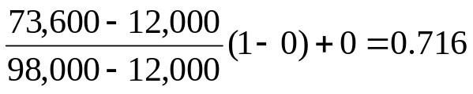

Normalization Example
Min-max normalization:
  Ex. Let income range $12,000 to $98,000 normalized to [0, 1]. Then $73,000 is mapped to
Z-score normalization
  Ex. Let μ = 54,000, σ = 16,000. Then

Slide 41
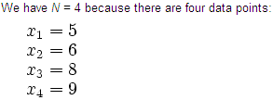




Standard Deviation
Mean Average
Standard Deviation

Slide 42
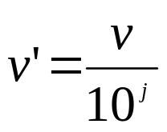
Data Transformation Example
Price in €
4
6
14
16
18
19
21
22
23
24
27
34
Min-max [0,1]
0
.06
.33
.4
.46
.5
.56
.6
.63
.66
.76
1
Z-score
-1.8
-1.6
-0.6
-0.3
-0.1
0
0.2
0.4
0.5
0.6
1
1.8
.04
.06
.14
.16
.18
.19
.21
.22
.23
.24
.27
.34
Decimal Scaling

Slide 43
Discretization
Discretization:
  Divide the range of a continuous attribute into intervals.
  Some classification algorithms only accept categorical attributes.
  Reduce data size by discretization, especially for numerical data
Discretization Methods
  Fixed k-Interval Discretization
  Cluster-Based Discretization
  Entropy-Based Discretization
 | Age | Buys Computer
1 | 10 | No
2 | 14 | No
3 | 20 | Yes
4 | 22 | Yes
5 | 44 | Yes
6 | 48 | No
7 | 52 | Yes
8 | 70 | No
9 | 76 | No
 | Age | Buys Computer
1 | 10 | No
2 | 14 | No
3 | 20 | Yes
4 | 22 | Yes
5 | 44 | Yes
6 | 48 | No
7 | 52 | Yes
8 | 70 | No
9 | 76 | No
 | Age | Buys Computer
1 | (0..17] | No
2 | (0..17] | No
3 | (17..55] | Yes
4 | (17..55] | Yes
5 | (17..55] | Yes
6 | (17..55] | No
7 | (17..55] | Yes
8 | (55...100] | No
9 | (55...100] | No

Slide 44
Fixed k-Interval Discretization
v_{min} is the minimum observed value
v_{max} is the maximum observed value
Intervals have width w = (v_{max} - v_{min}) / k
The cut points are
v_{min} + w , v_{min} + 2w , ... , v_{min} + (k - 1)w
Replace continuous values in Attribute with discrete ranges or labels

Slide 45
Fixed k-Interval Discretization
Use Fixed 4-Interval Discretization method to discretize the following dataset.
( 82 – 10 ) / 4 = 72 / 4 = 18
[10 – 28]
(28 – 46]
(46 – 64]
(64 – 82]
Customer ID | Age
1 | 10
2 | 14
3 | 20
4 | 22
5 | 44
6 | 48
7 | 52
8 | 70
9 | 76
10 | 82
Customer ID | Age
1 | 10 - 28
2 | 10 - 28
3 | 10 - 28
4 | 10 - 28
5 | 28 - 46
6 | 46 - 64
7 | 46 - 64
8 | 64 - 82
9 | 64 - 82
10 | 64 - 82

Slide 46
Slides are acknowledged from:
Asst. Prof. Dr. Derya BİRANT

